Slide 1
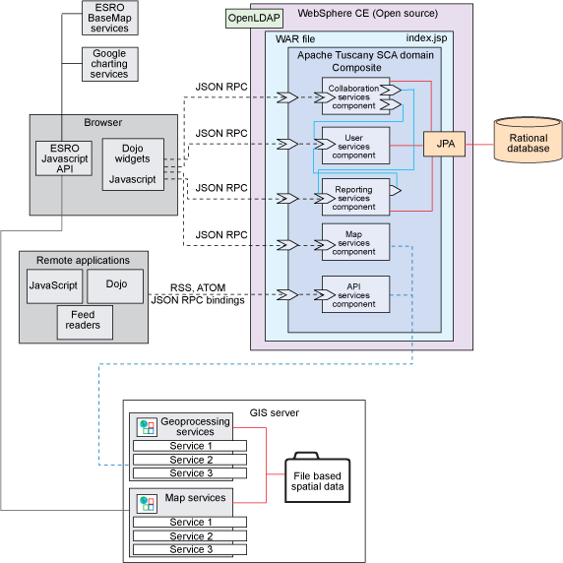

Slide 2
API
Security
TX
Command API
Other APIs
Services
Spatial
Non-spatial
Domain
POJO
Persistence
Hibernate
Spatial
database

Slide 3

Dojo Face
GWT Face
???
Rendered Feature
Raster Image
???
Server API
Feature command
Raster Command
Geoprocessing Command
???
Application
Map
VectorLayer
RasterLayer
Geotools LayerModel
Hibernate LayerModel
Custom LayerModel
Google Layer
WMS Layer
???
Feature
POJO
???
OGC/other Services
Spatial DB

Slide 4
Geomajas
Custom plug-in
backend
backend api
backend api
Custom layer
backend api
backend api
backend api
Custom face
dojo face server
GWT face server
server
face
internal
face
internal
client
dojo face client
GWT face client
dojo
face api
GWT
face api
dojo app
GWT app

Slide 5
backend
Command X
Command Z
Command Y
5
execute command
Get response, handle exceptions
CommandDispatcher
4
SecurityManager
6
Check security
CommandResponse
For display, these are typically Tile instances,
Which contain
the Features to render (if any)
a link to a (raster) image
Command name,
CommandRequest,
User token
CommandRequest
CommandResponse
3
7
serialized
Face server
2
CommandRequest
Face client
CommandResponse
8
1
serialized

Slide 6
Geomajas backend
Geomajas-api
command
…
Geomajas-impl
common-servlet
…

Slide 7
Getting a RenderedTile
Getting the tile image
VectorRendering
cache
broker
Paint layer
TileImageCreator
FeaturePainter
get data
TilePainter paint
call painters

Slide 8
SecurityManager
Authentication mechanism
(for example SSO server)
Security Services
Security Service
Policy store
(for example PERMIS)
…
SecurityContext
UserInfo
Authentication
…

Slide 9
Geomajas
Spring IoC
Hibernate spatial
Layers / data access library
iText
Printing plug-in
Spatial services
Geotools
Rules plug-in
drools
Caching plug-in
infinispan
dojo face server
GWT face server
JTS
server
face
internal
face
internal
client
dojo
dojo face client
GWT face client
GWT

Slide 10
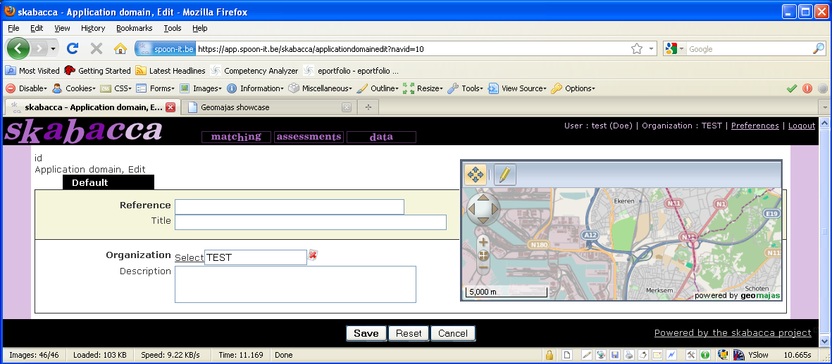
Spatial Application Server
ERP
shared
transaction
Geomajas GIS
data

Slide 11
Client / faces
Secured
zone
Command dispatcher
Command
…
Command
Command
…
Command
Action based services
Raster layer service
Other services
Custom service
Vector layer service
Custom service
Topic based services
Security context
Raster Layer
Vector Layer
Transform (e.g. map/geo-server)
Transform (e.g. map/geo-server)
Authentication service (e.g. SSO)
Policy service (e.g. Permis)

Slide 12
Pipeline
Step
Step
Step

